Slide 1
Population structure
PCA
UMAP
ADMIXTURE
ConStruct

Slide 2
Principal Component Analysis (PCA)
Input: data with multiple (potentially correlated) measurements
Desired output:
geometrically the same distribution of the data points, represented
in uncorrelated (orthogonal) coordinate axes and rotated to display the most important axes first
Unlike heatmap / hierarchical clusters in the earlier slide, allows for statistical tests to verify significance of the observed groupings.

Slide 3
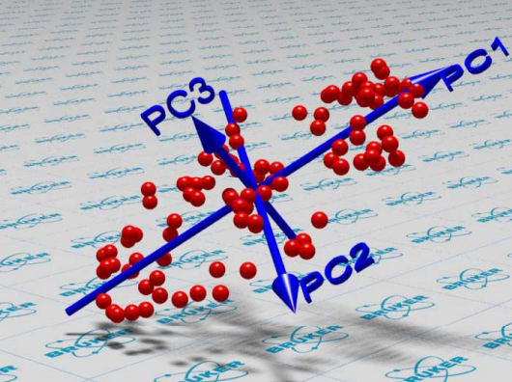
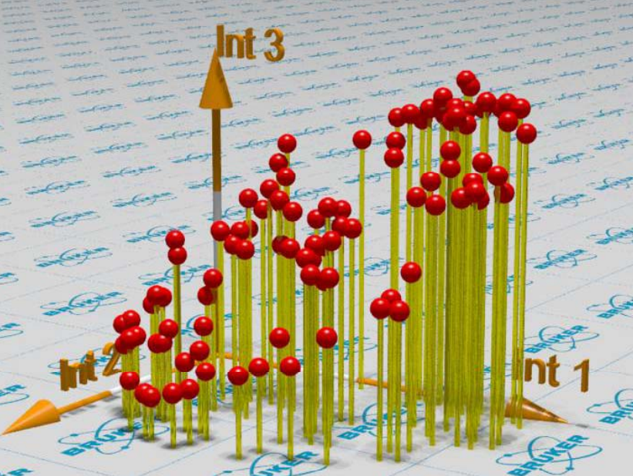
Principal Component Analysis

Slide 4
Principal Component Analysis

Slide 5
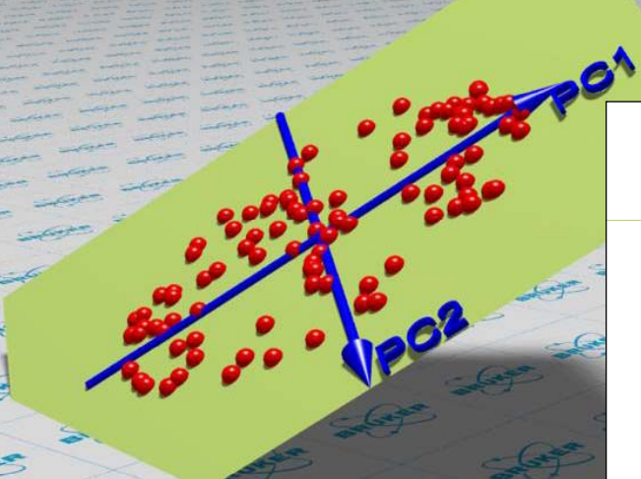
Principal Component Analysis

Slide 6
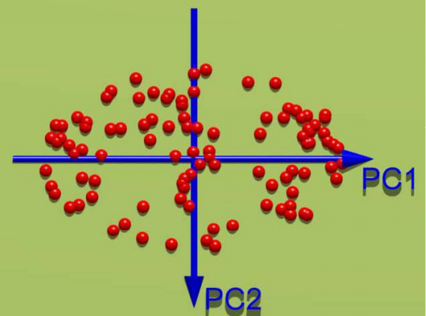
Principal Component Analysis

Slide 7
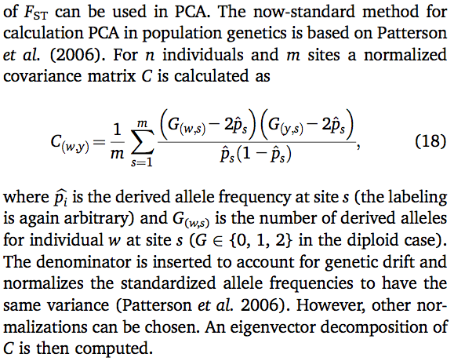
SNP covariance matrix

Slide 8
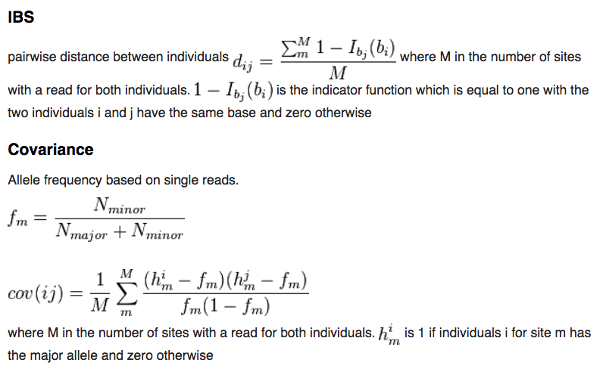
ANGSD: similarity matrices based on sampling a single read per SNP
(robust to variation in coverage among samples!)

Slide 9
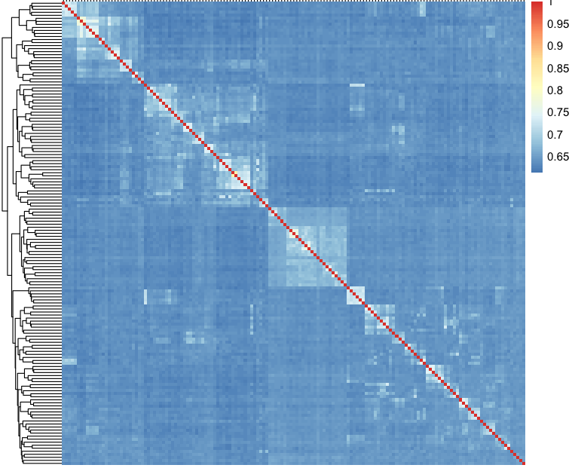
Genetic similarity matrix for 153 singing mice

Slide 10
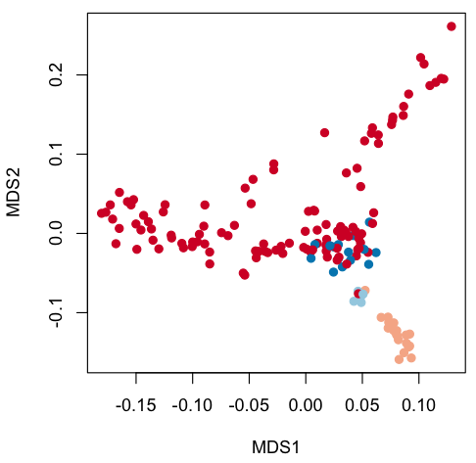
PCoA: takes not the original point coordinates, but square matrix of distances between points
vegan::capscale
vegan::adonis (to test for significance of grouping by specific factor)

Slide 11
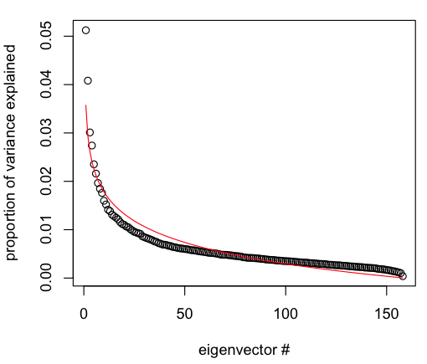
How many interesting PCs are there?
Plot proportions of variance explained by each consecutive PC
NB: there is no hard cutoff! % of variance explained by leading components always declines with sample size - extra samples → more noise → relevant variation constitutes smaller proportion
There are many formal tests which are rarely used
Compare to “broken stick” model (red line) – expected null distribution of eigenvector values - if you randomly broke a stick of length 1 into N bits, that would be the distribution of bit lengths

Slide 12
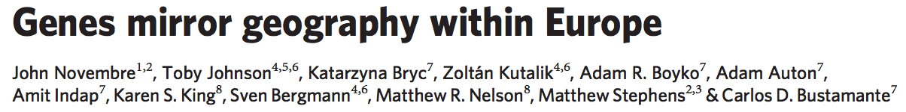
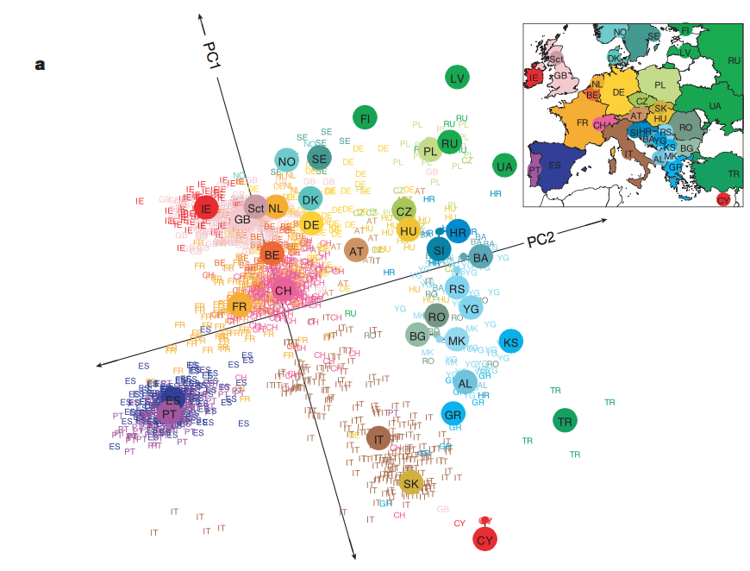

Slide 13
For GWAS, include the first few PCs as covariates to account for population structure

Slide 14
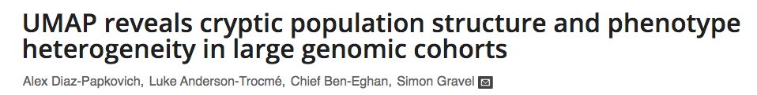
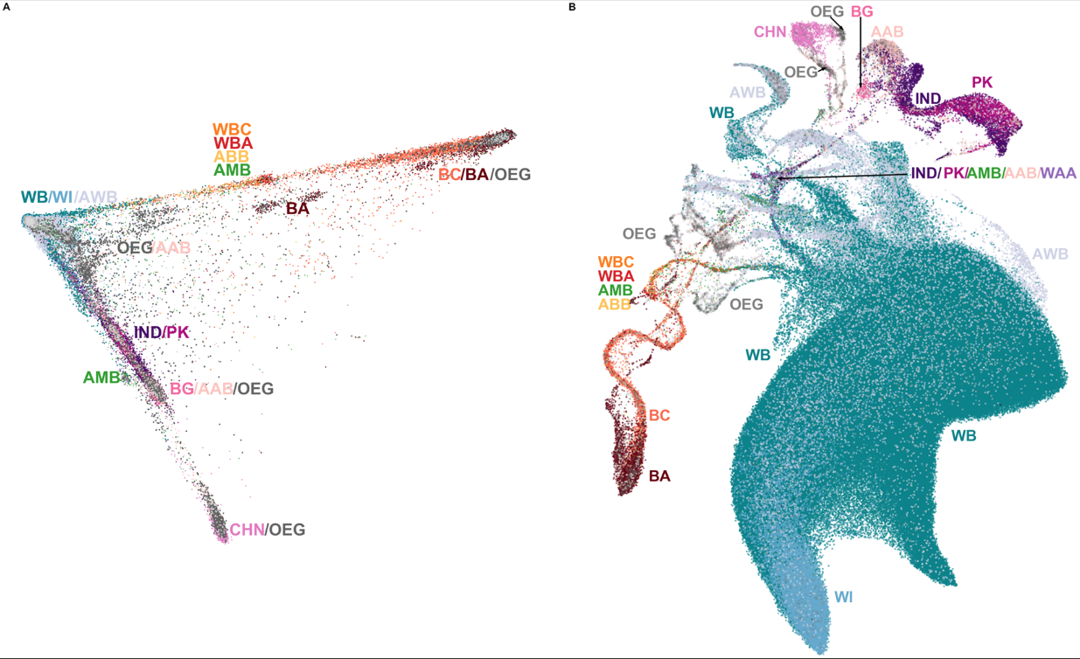
UK biobank: PCA
Colored by self-reported ancestry
PC1-PC2 projection reveals only the most prominent patterns of genetic divergence →
In large datasets, many meaningful genetic subdivisions might not be visible in a PCA plot.

Slide 15
Prioritizes local structure,
does not preserve long-distance similarities
Uniform Manifold Approximation and Projection (UMAP)
UK biobank: PCA

Slide 16
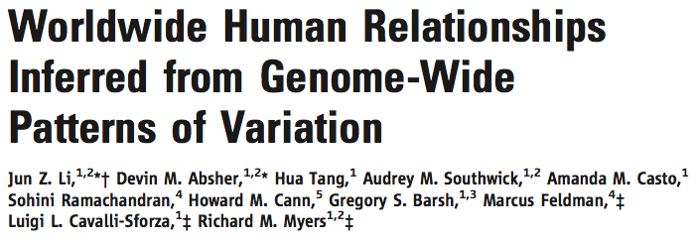
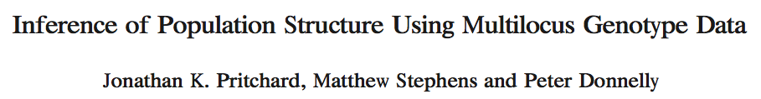
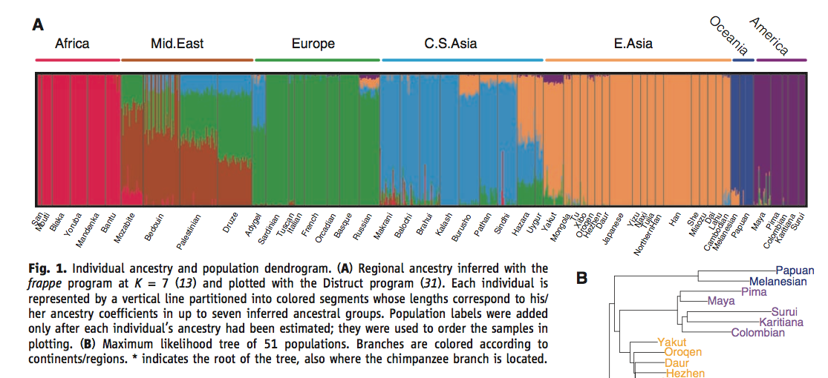
2000:
STRUCTURE / ADMIXTURE
Model-based:
assumes K “ancestral components” (populations) with AFs in HWE
represents each individual’s genotype as a mix of these ancestral populations
must thin data to avoid LD and remove highly differentiated outliers

Slide 17
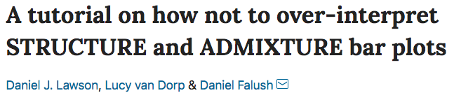
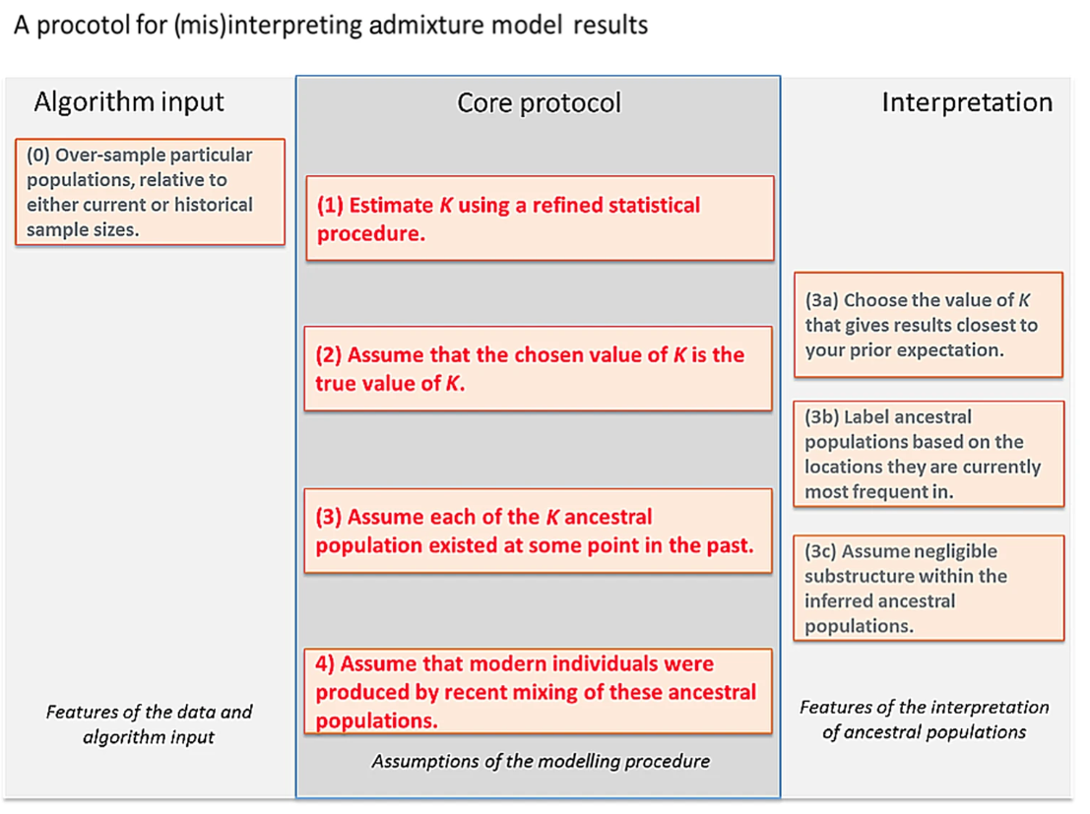

Slide 18
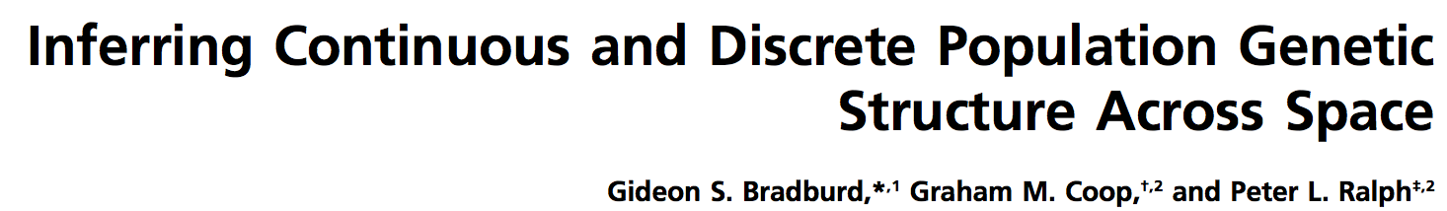
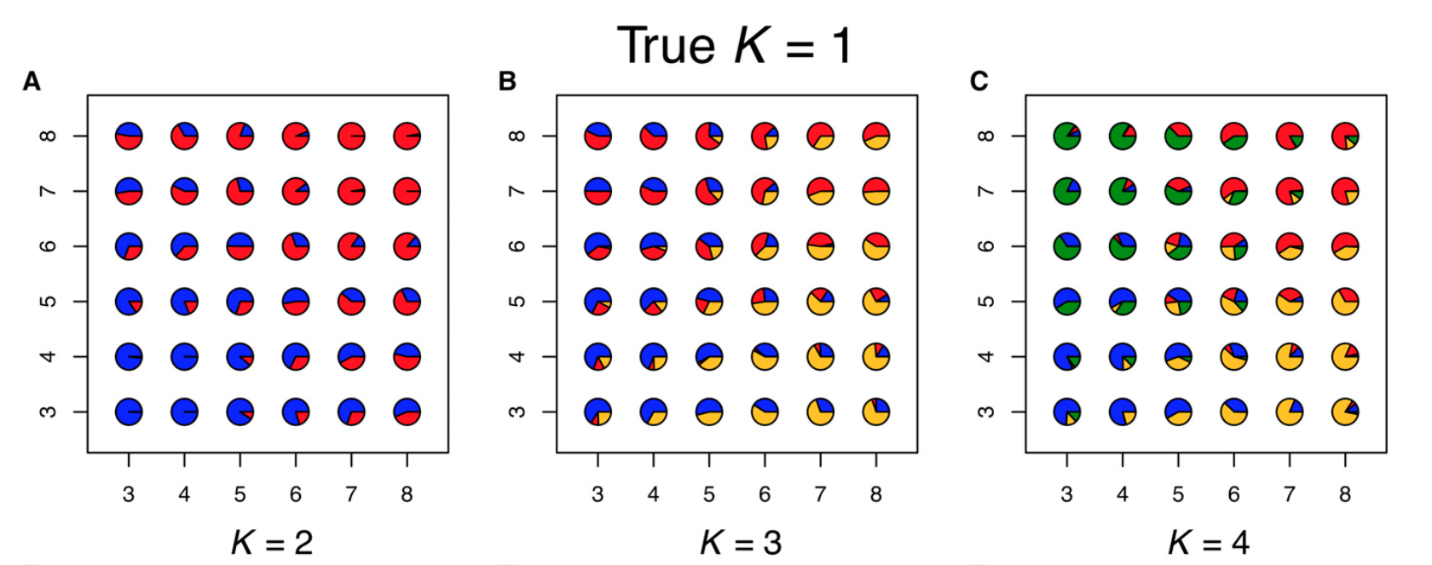
Continuous vs. discrete differentiation
Gradual accumulation of genetic divergence with distance looks (to ADMIXTURE) like emergence of separate genetic clusters
ADMIXTURE
The problem is to tell the difference from situations where we have abrupt bariers to gene flow.

Slide 19
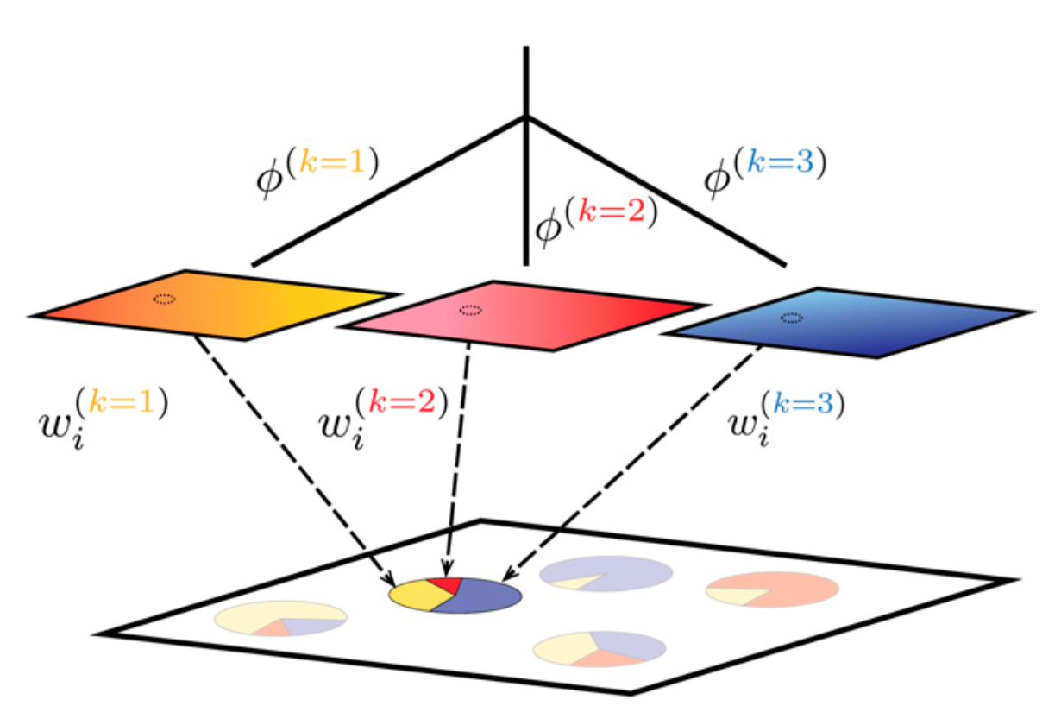
Continuous vs. discrete differentiation
conStruct
Let’s imagine that we have several “layers” (analogous to “ancestral components” of ADMIXTURE) in each of which genetic divergence accumulates with distance, and these “layers” are mixed in different proportions in each individual.
Gradual change in allele frequencies → within the same ”layer”
Abrupt shift in allele frequencies → switch between “layers”
Notes:
Figure 1 Schematic of our method, using K 1⁄4 3 as an example. Spatial
autocorrelation of allele frequencies within each layer is depicted by color
gradients, and fðkÞ denotes the covariance shared by samples with an-
cestry entirely in the kth layer. Sampled populations on the landscape are
inferred to be admixed between these layers; the ith sample draws pro-
portion wðkÞ of its ancestry from layer k. For convenience, each layer is i
depicted as a small square, but in fact, each layer exists everywhere in the sampled area, so the small dashed circles on each layer show where the location of the highlighted admixed sample intersects each layer.

Slide 20
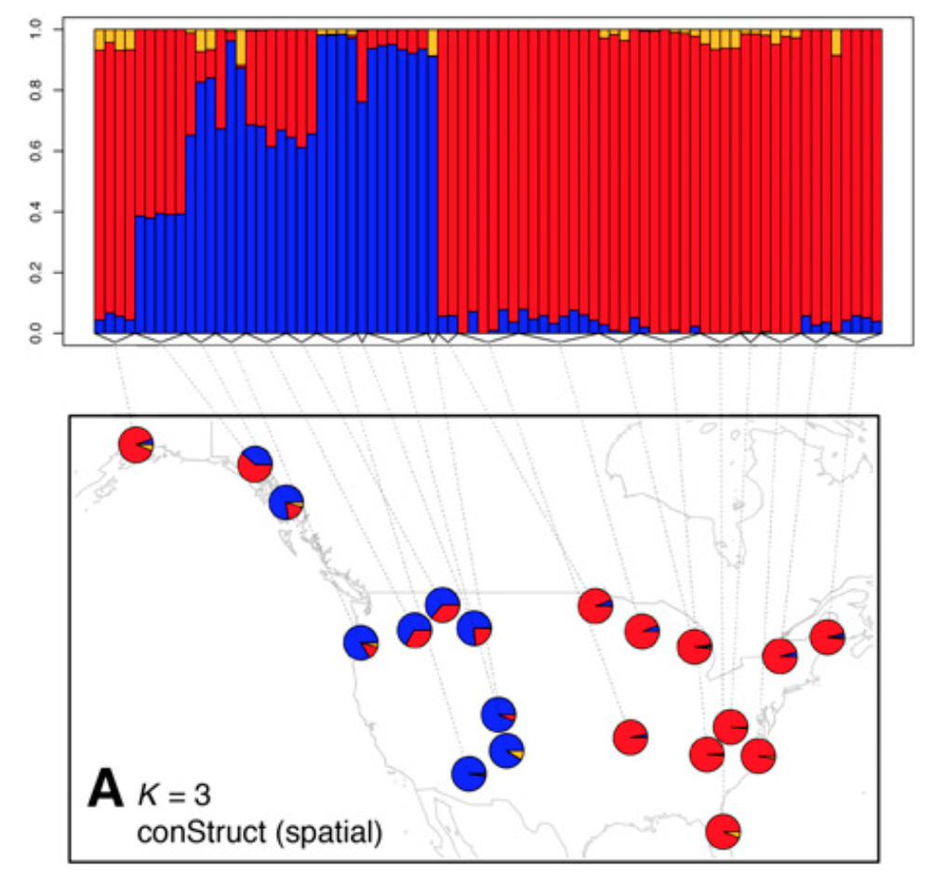
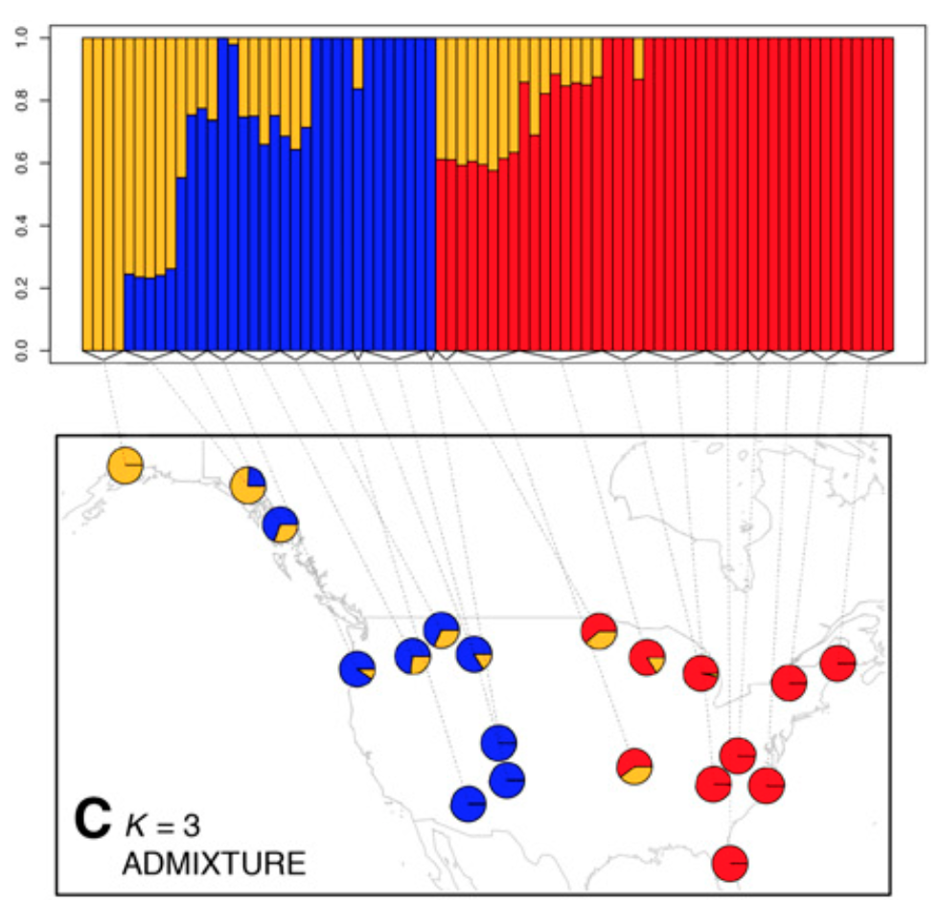
Black bears
conStruct infers two “layers”, while ADMIXTURE regards far-flung bear populations of the “red” type as a separate genetic cluster.

